Slide 1
DynaMAT
Dynamical and creative mathematics using ICT
IV Nordic GeoGebra Conference
Copenhagen, Denmark 2013
Freyja Hreinsdóttir, Henning Westphael, Guðrún Margrét Jónsdóttir

Slide 2
DynaMat
Comenius project – Lifelong Learning Program
http://eacea.ec.europa.eu/llp/index_en.php
3 years Dec. 2010 – Nov. 2013
Project of 6 partners:
  Pisa, Italy – Vladimir Georgiev
  Sofia, Bulgaria – Oleg Mushkarov + team
  Nitra, Slovakia – Sona Ceretkova + team
  Vienna, Austria – Andreas Ulovec
  Århus, Denmark – Henning Westphael (John Andersen)
  Reykjavík, Iceland – Freyja Hreinsdóttir

Slide 3
Website
Our website is maintained in Slovakia at
http://www.dynamathmat.eu/
- material

Slide 4
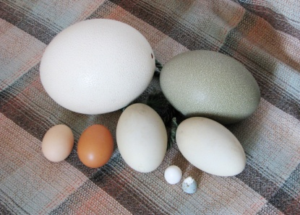
Eggs
Four-point egg
Five-point egg
Moss egg
Source for Euclidean Eggs:
Dixon, R. Mathographics. Basic Blackwell Limited, Oxford, England, 1987

Slide 5
Euclidean eggs
Exercise with arcs and circles
When is the meeting of the arc smooth?

Slide 6
Moss egg
Moss egg – GeoGebra file

Slide 7
Four-point egg

Slide 8
Four-point egg

