Slide 1
DynaMAT
Dynamical and creative mathematics using ICT
Third Nordic GeoGebra Conference
Tartu, Estonia
Freyja Hreinsdóttir

Slide 2
DynaMat
Comenius project – Lifelong Learning Program
http://eacea.ec.europa.eu/llp/index_en.php
3 years Dec. 2010 – Nov. 2013
Project of 6 partners:
  Pisa, Italy – Vladimir Georgiev
  Sofia, Bulgaria – Oleg Mushkarov + team
  Nitra, Slovakia – Sona Ceretkova + team
  Vienna, Austria – Andreas Ulovec
  Århus, Denmark – John Andersen
  Reykjavík, Iceland – Freyja Hreinsdóttir

Slide 3
Goal and planned results of the project
The goal is to produce didactic material for the use of ICT in mathematics
1. E-Book with materials (translated to our languages)
2. Preliminary Course, e-learning course and workshop for pre- and in-service-teachers
3. Web-page containing e-book,materials for courses and a platform for e-learning course.
4. Final conference in 2013 in Slovakia to present materials to teacher educators, teachers and teacher students, with workshops to actively work with and develop further materials.

Slide 4
Website
Our website is maintained in Slovakia at
http://www.dynamathmat.eu/

Slide 5
How we work
Each partner wrote/collected at least 5 chapters, 10 page each
During meetings this was reviewed and discussed
External reviewer also gave feedback
We try out material in different countries and collect feedback from teachers
At least one chapter from each country is translated into other languages

Slide 6
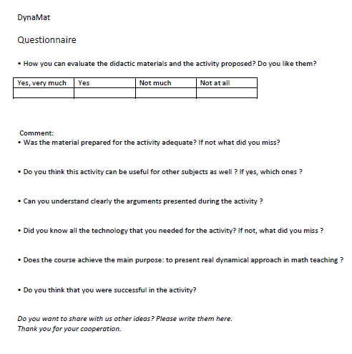

Slide 7
The material
My material:
Euclidean eggs
Functions and sliders
2 by 2 matrices – two chapters on how to use the two graphic views in GeoGebra to investigate maps from the plane to the plane
Piecewise defined functions

Slide 8
Two graphic views
In GeoGebra 4.0 the option of having two graphic views open at the same time makes it possible to study maps from the plane to plane
Linear maps are particularly easy to study
There are two ways to do this:
  defining a 2 x 2 matrix
  defining the action on one point and using the trace option

Slide 9
A transformation

Slide 10

2x2 matrices
A 2x2 matrix can be defined as a list of lists in the input field. Also possible to do this in the spreadsheet
If we define sliders a, b, c, d and then the matrix then we can easily change the matrix and study the effects of that.
The command ApplyMatrix[matrix, object] is very useful in this context

Slide 11
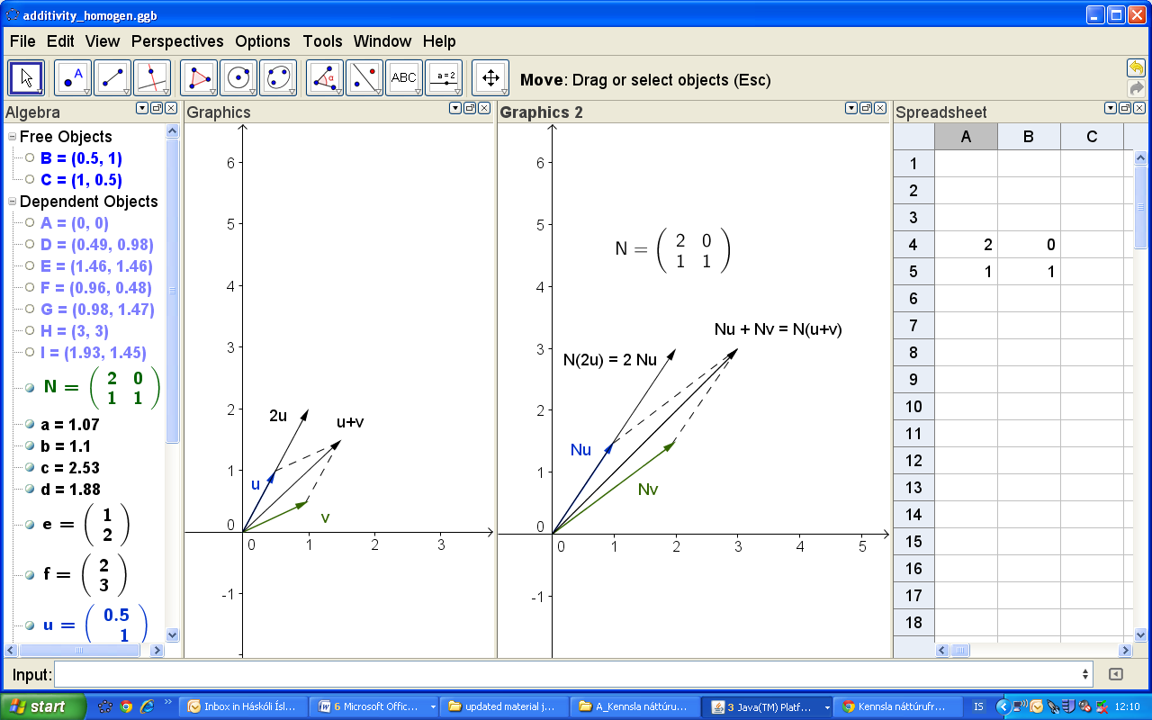
Demonstrate additivity and homogeneity of linear maps
Also very easy to demonstrate that a linear transformation
maps lines to lines

Slide 12
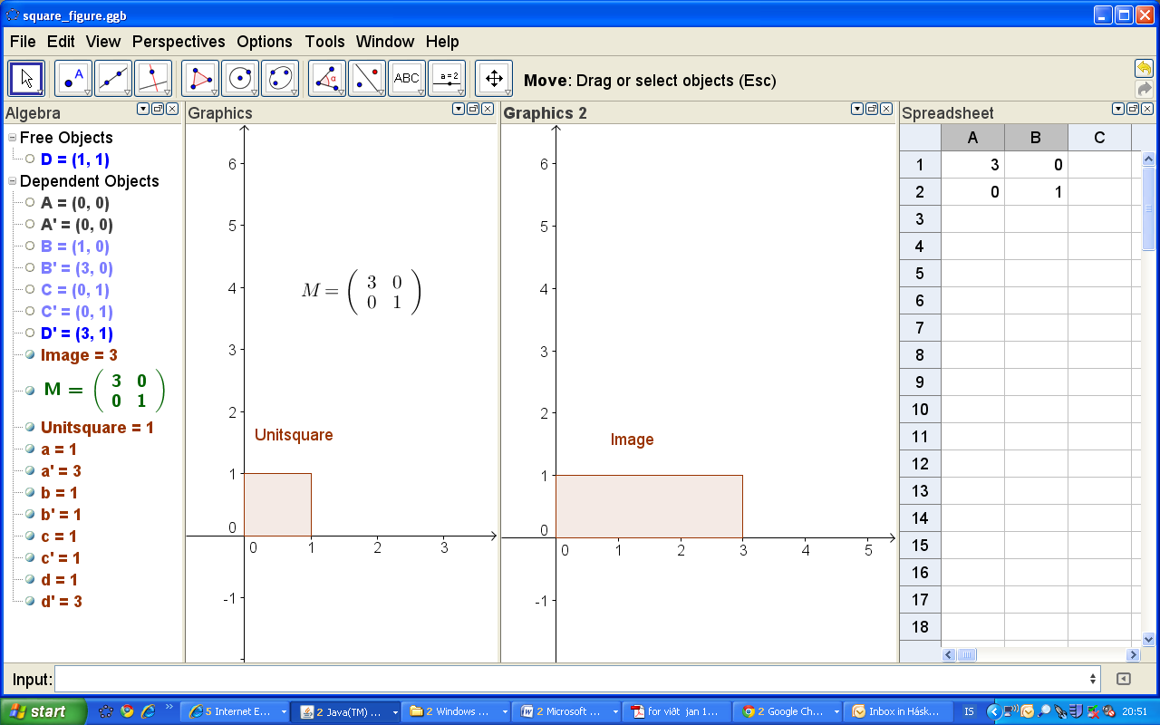
Image of the unit square

Slide 13
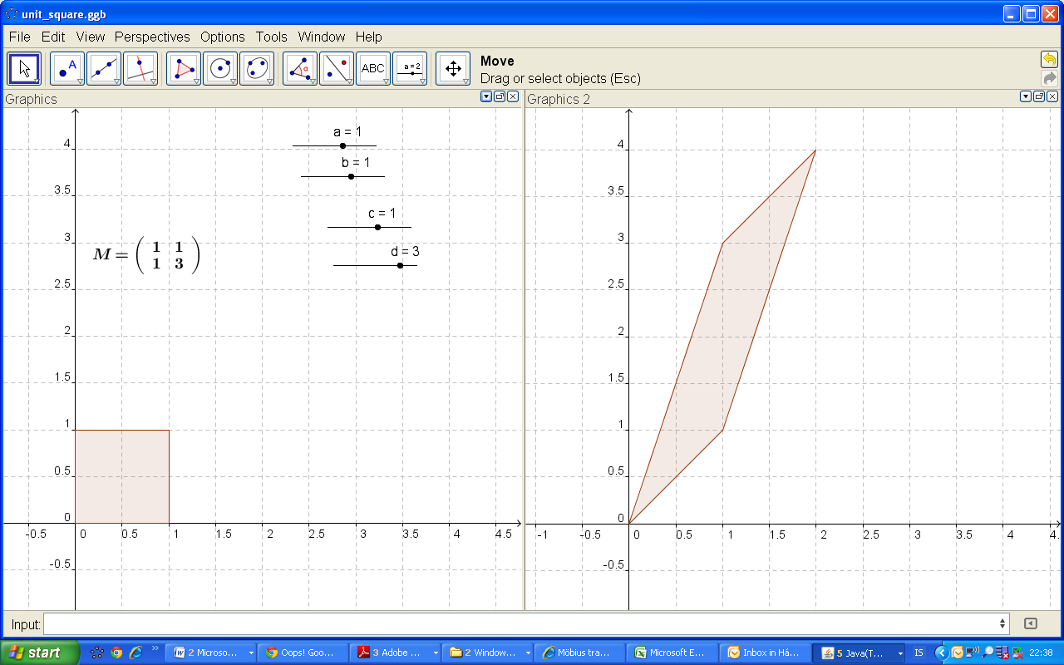
The area of the image of the unit square - determinants

Slide 14
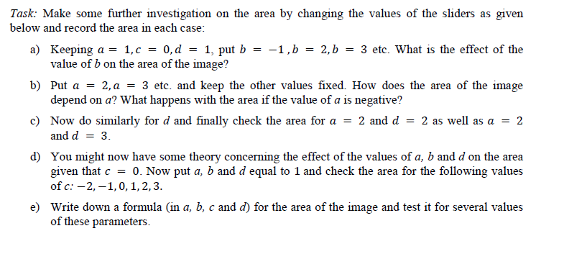

Slide 15
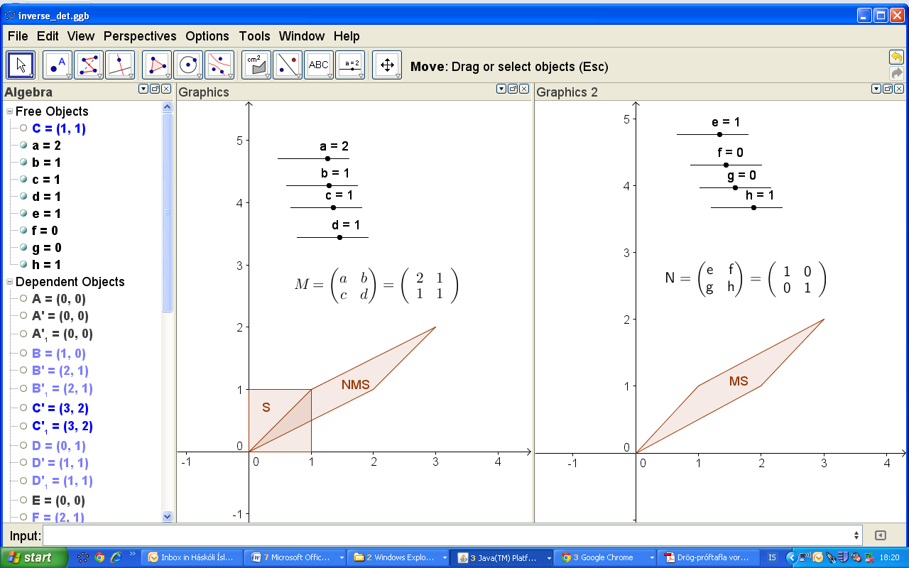
The inverse of a matrix

Slide 16
Another way to sudy the effects of matrices
Given a point (x, y) in Graphics view 1 we can define a new point in Graphics view 2 by applying a linear map to the point.
We can then put the trace on the point in Graphics view 2 and move (x,y) around in Grephics view 1
This is particularly interesting to see when we define the first point as a point on an object e.g. a line or a circle.

Slide 17
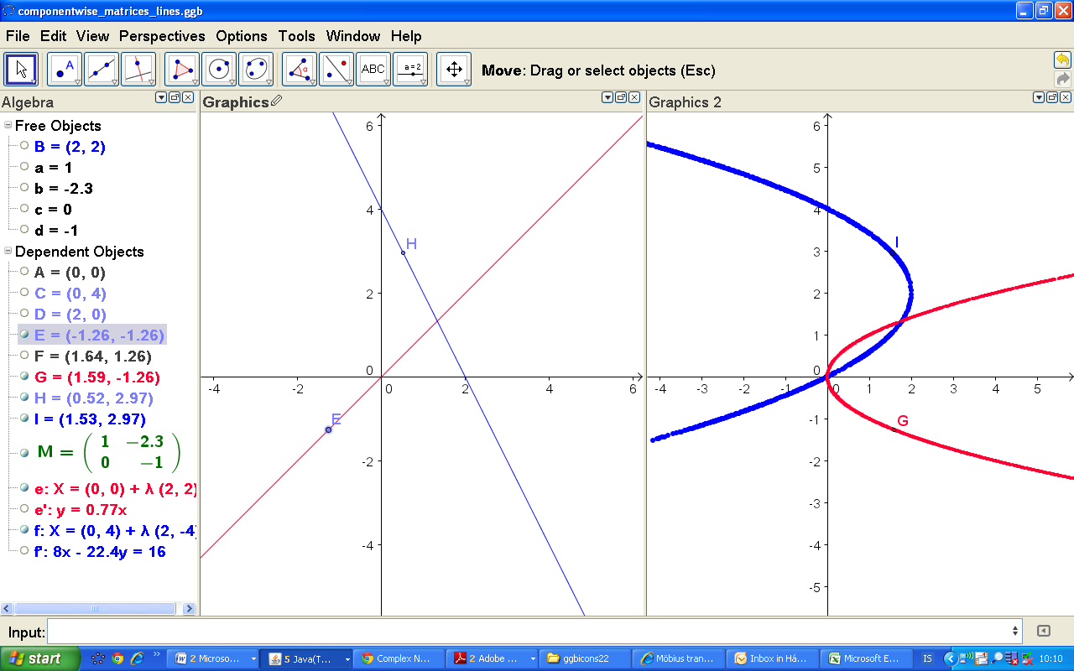
Nonlinear map
The method above can be used for any transformation, even non-linear ones. Say we want to study the map
We define a point E on a line and then the point G = in Graphic view 2. We then put the trace on G and move the point E along the line and watch the image trace out a curve in Graphics 2.

Slide 18

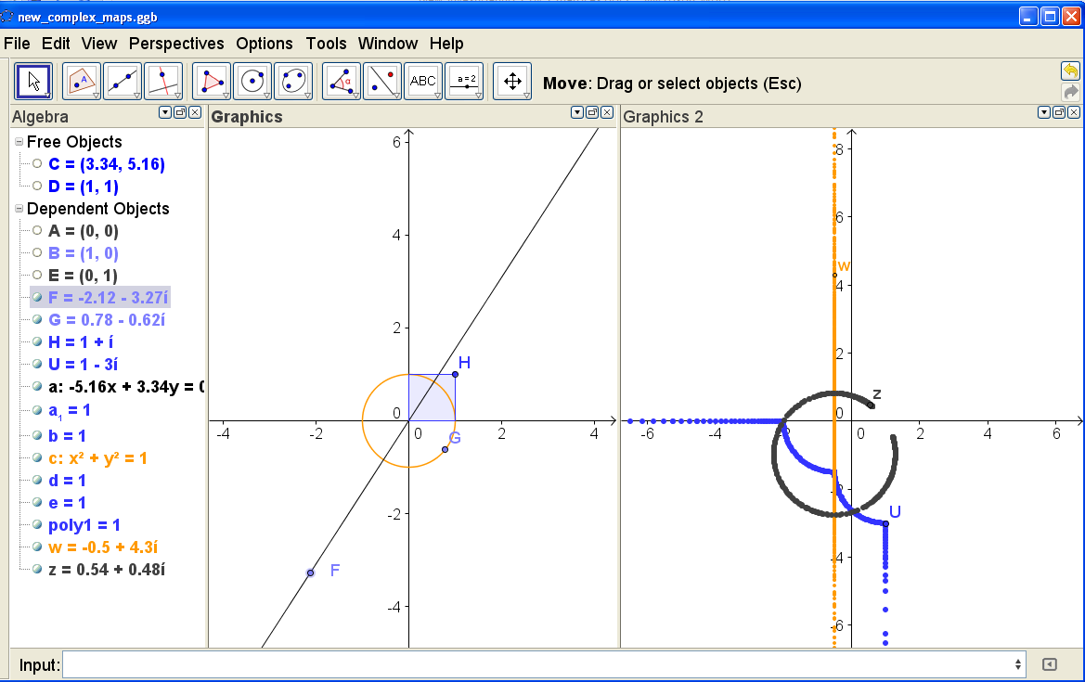
Maps from the complex numbers to the complex numbers
We can use a similar method to study maps from C to C, e.g.
Image of a line, circle and the boundary of a square

Slide 19
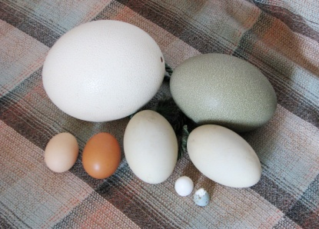
Eggs
Four-point egg
Five-point egg
Moss egg
Source for Euclidean Eggs:
Dixon, R. Mathographics. Basic Blackwell Limited, Oxford, England, 1987

Slide 20
Euclidean eggs
Exercise with arcs and circles
When is the meeting of the arc smooth?

Slide 21
Moss egg
Moss egg – GeoGebra file

Slide 22
Four-point egg

Slide 23
Four-point egg

Slide 24
Other partners
GPS – work from Austria, Denmark and Slovakia
Art – work from Bulgaria
Playground mathematics – from Slovakia
Mathematical work from Italy

Slide 25
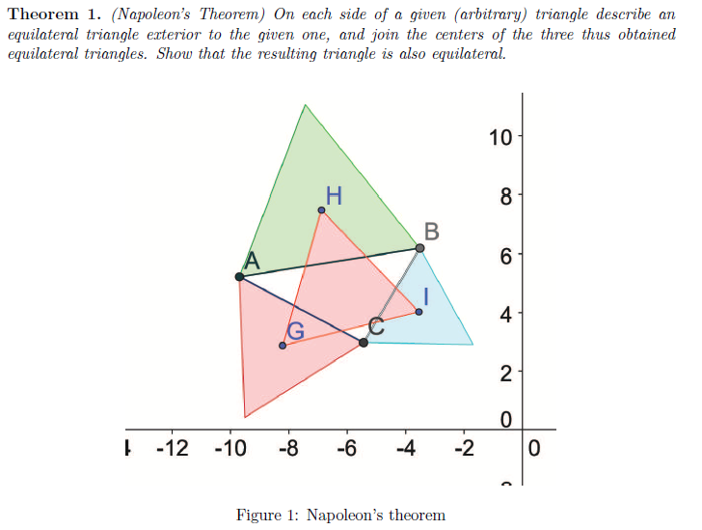
Napoleons problem (Italy)
GeoGebra is used to
play with generalisations
of the theorem

Slide 26
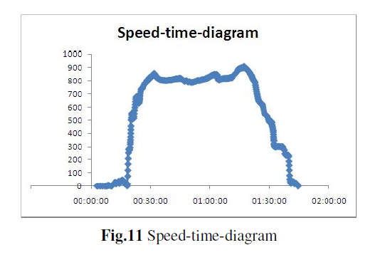
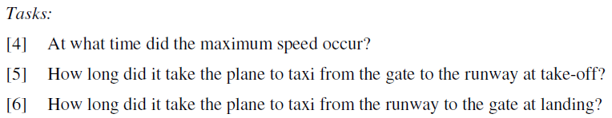
Example from Vienna
Aviation
Flight from Copenhagen to Vienna – GPS on
Data into Excel

Slide 27
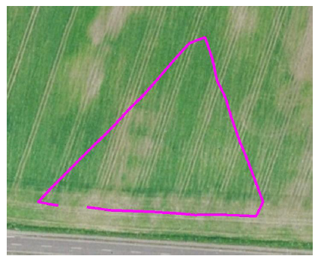
Example from Denmark
Geometry in the field - GPS
The result looks like a triangle but certainly not an equilateral one. Zooming do not make you happier
Fig. 8 Zooming in on "equilateral" triangle

Slide 28
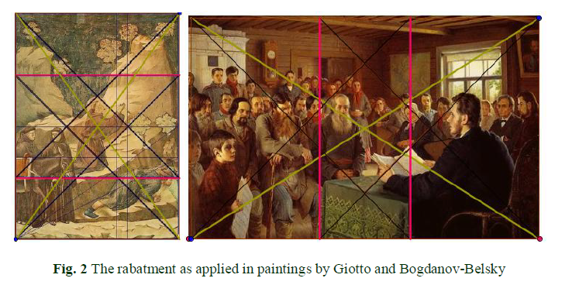
Dyna-Art (Bulgaria)

Slide 29
Website
Please check out the material on
http://www.dynamathmat.eu/
Thank you!

