Slide 1
DynaMAT
Dynamical and creative mathematics using ICT
Second Nordic GeoGebra Conference
Vilnius, Lithuania
Freyja Hreinsdóttir

Slide 2
DynaMat
Comenius project – Lifelong Learning Program
http://eacea.ec.europa.eu/llp/index_en.php
3 years Dec. 2010 – Nov. 2013
Project of 6 partners:
  Pisa, Italy – Vladimir Georgiev
  Sofia, Bulgaria – Oleg Mushkarov + team
  Nitra, Slovakia – Sona Ceretkova + team
  Vienna, Austria – Andreas Ulovec
  Århus, Denmark – John Andersen
  Reykjavík, Iceland – Freyja Hreinsdóttir

Slide 3
Goal and planned results of the project
The goal is to produce didactic material for the use of ICT in mathematics
1. E-Book with materials (translated to our languages)
2. Preliminary Course, e-learning course and workshop for pre- and in-service-teachers
3. Web-page containing e-book,materials for courses and a platform for e-learning course.
4. Final conference in 2013 to present materials to teacher educators, teachers and teacher students, with workshops to actively work with and develop further materials.

Slide 4
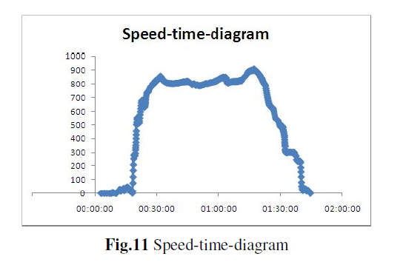
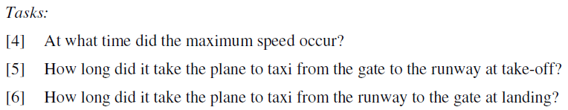
Example from Vienna
Aviation
Flight from Copenhagen to Vienna – GPS on
Data into Excel

Slide 5
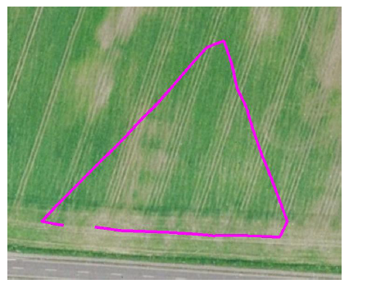
Example from Denmark
Geometry in the field - GPS
The result looks like a triangle but certainly not an equilateral one. Zooming do not make you happier
Fig. 8 Zooming in on "equilateral" triangle

Slide 6
Example from Iceland
Euclidean eggs
Exercise with arcs and circles
When is the meeting of the arc smooth?

Slide 7
Arc and circles

Slide 8
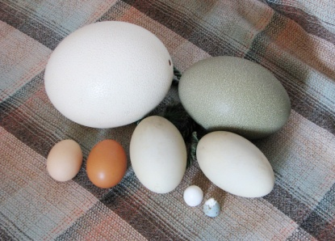
Eggs
Four-point egg
Five-point egg
Moss egg
Source for Euclidean Eggs:
Dixon, R. Mathographics. Basic Blackwell Limited, Oxford, England, 1987

Slide 9
Moss egg
Moss egg, Variation of a Moss egg

Slide 10
Four-point egg

Slide 11
Four-point egg

Slide 12
GeoGebra files
Four-point egg
Five-point egg
Experiment_circles
Spiral

